Slide 1
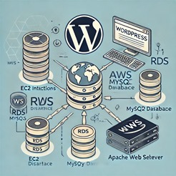
Overview of WordPress Web Application Deployment
G.Vinay
Using AWS, Docker,
Jenkins, Terraform,
and Kubernetes

Slide 2
Deploying WordPress with AWS RDS and EC2
Steps involved in deploying WordPress using AWS:
- Create an RDS instance with MySQL
- Launch EC2 instance with Amazon Linux 2
- Install Apache web server and MySQL client
- Connect EC2 to RDS and configure WordPress

Slide 3
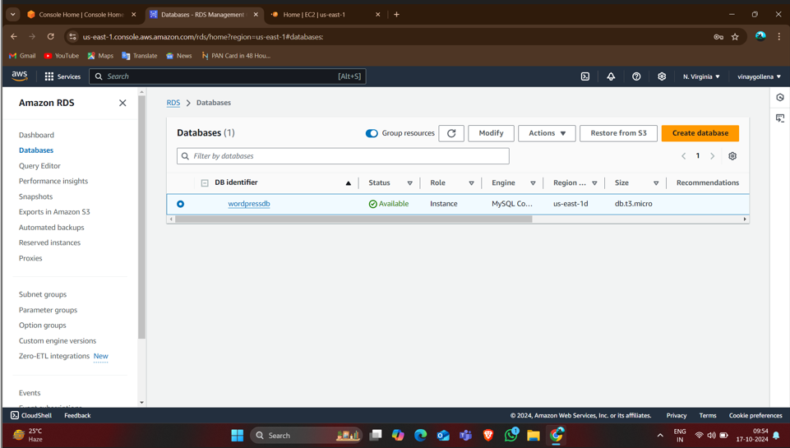
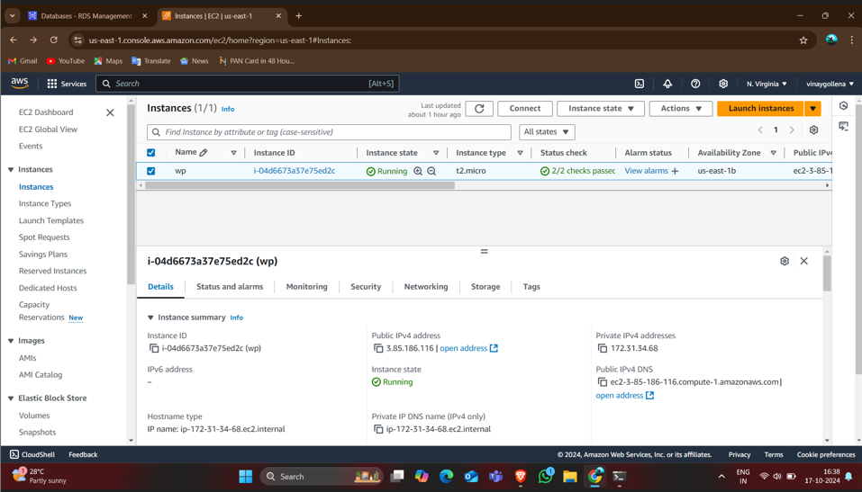
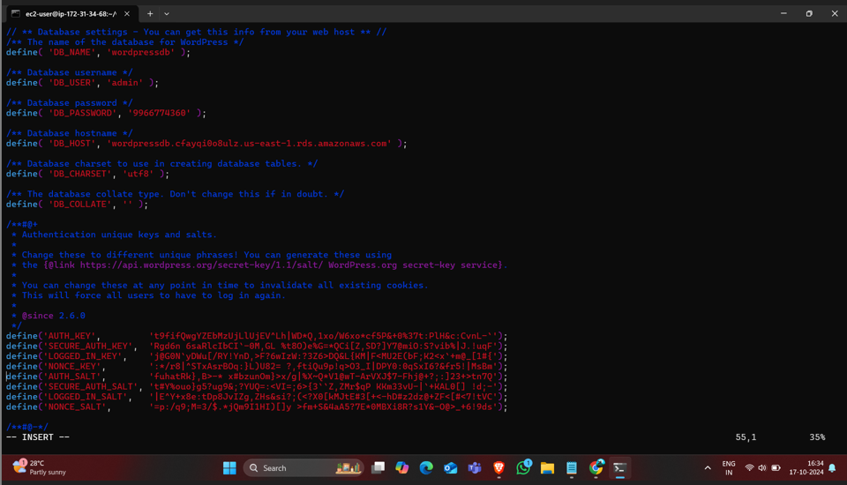
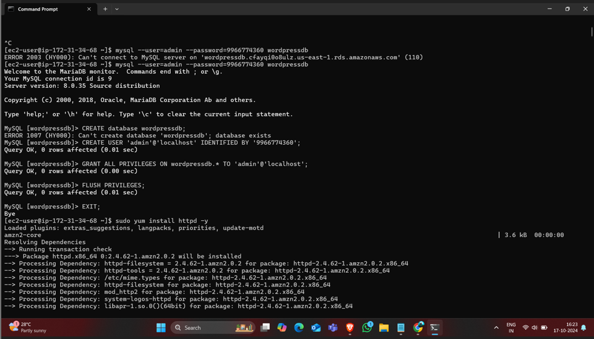
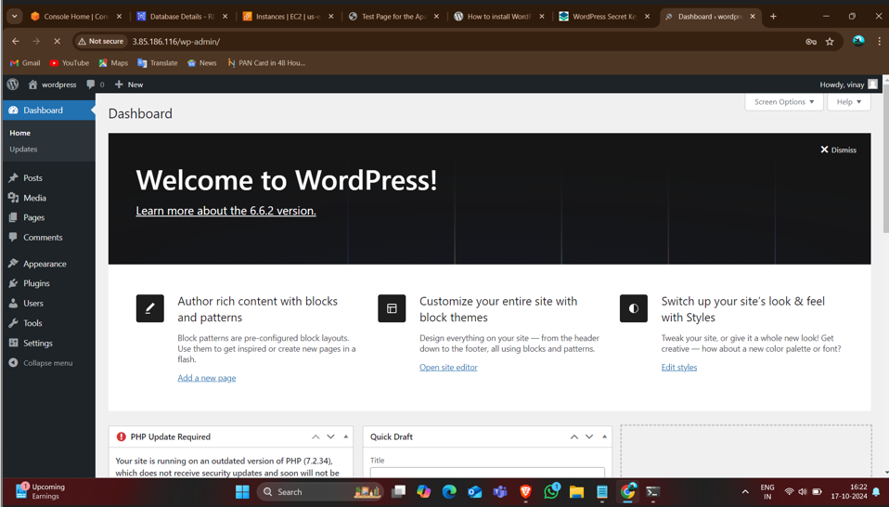

Slide 4
WordPress Deployment with Docker
Steps to deploy WordPress using Docker:
Install Docker on EC2 instance
Use Docker Compose to pull MySQL and WordPress images
Launch WordPress application with Docker

Slide 5
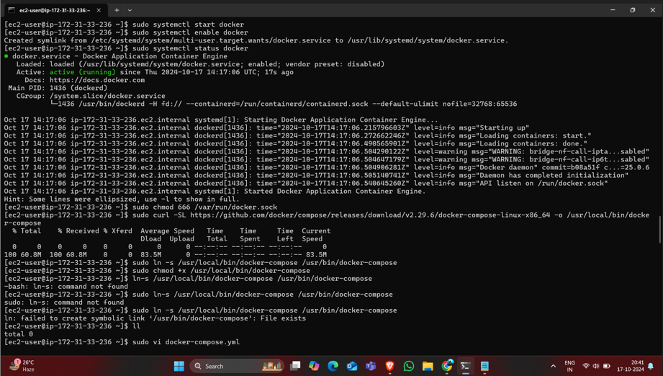
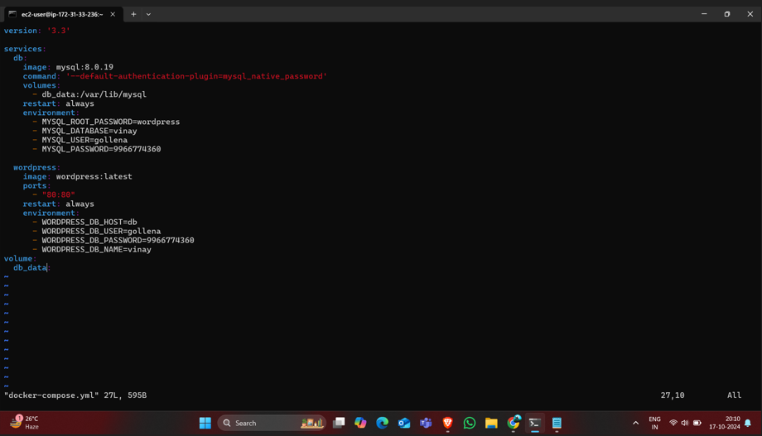
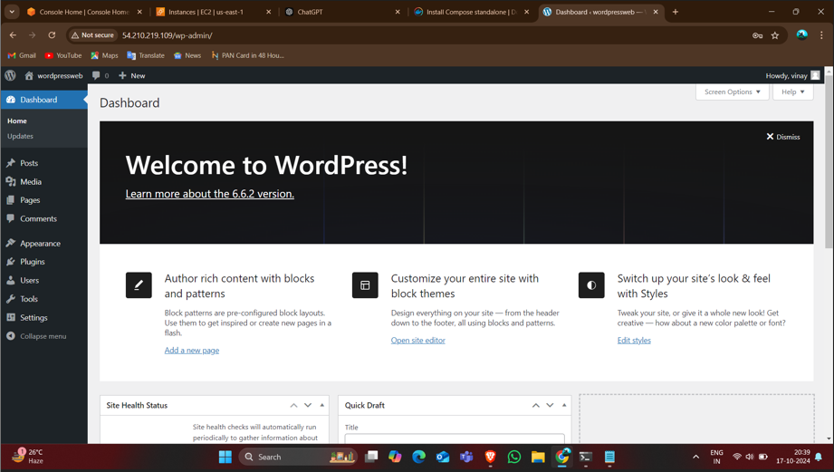

Slide 6
Using Jenkins and Git for WordPress Deployment and also with the execute shell
Steps to deploy WordPress with Jenkins:
Create EC2 instance and install Jenkins
Clone WordPress repository using Git
Configure Jenkins job to deploy WordPress
Write the bash script in execute shell.

Slide 7
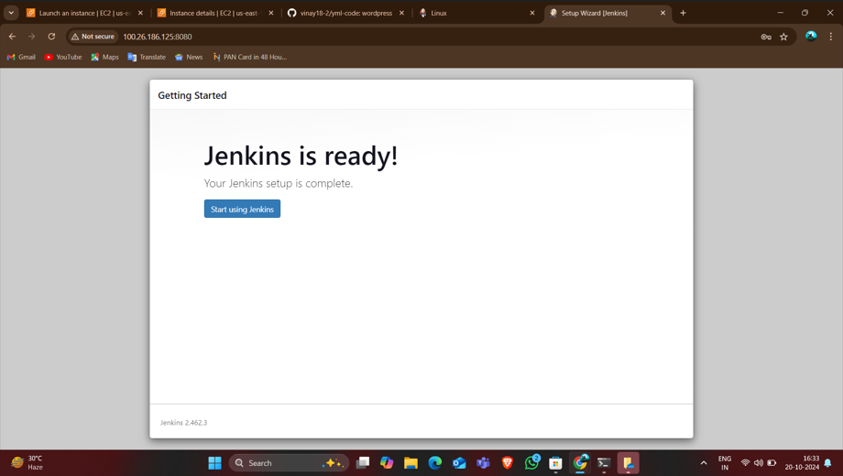
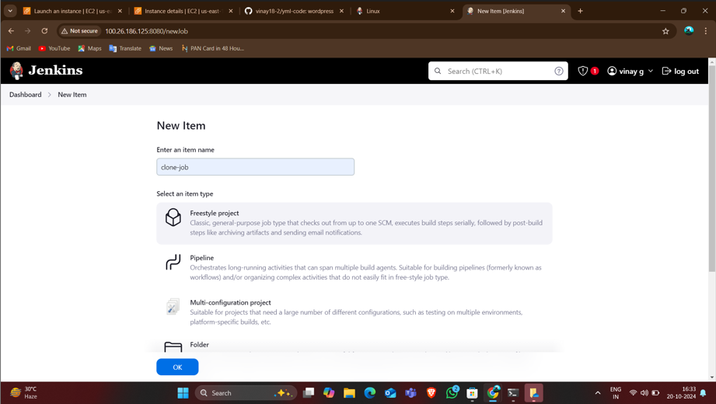
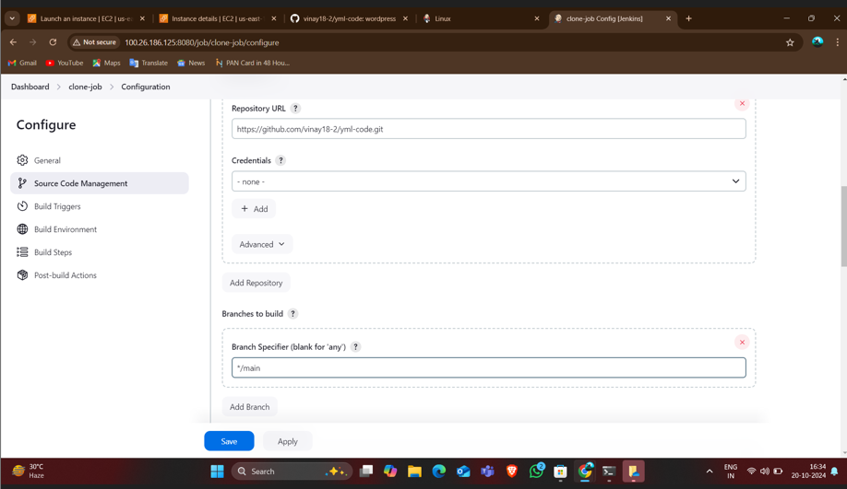
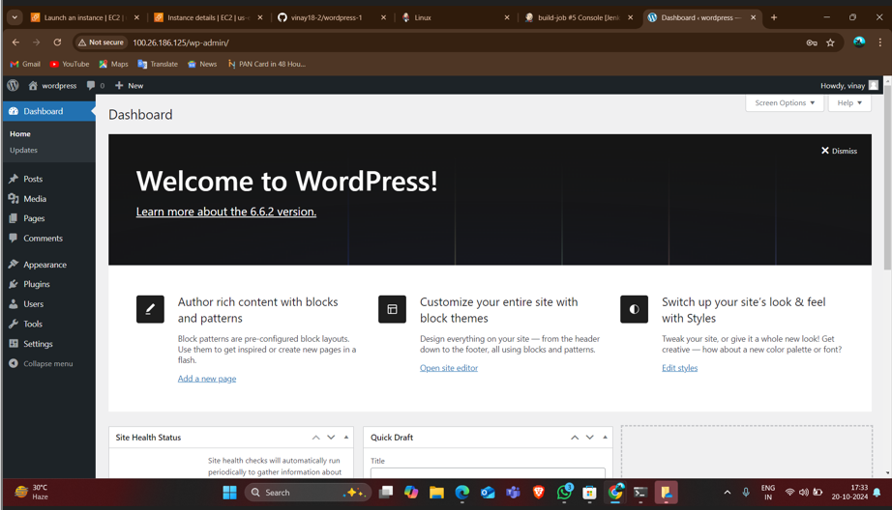
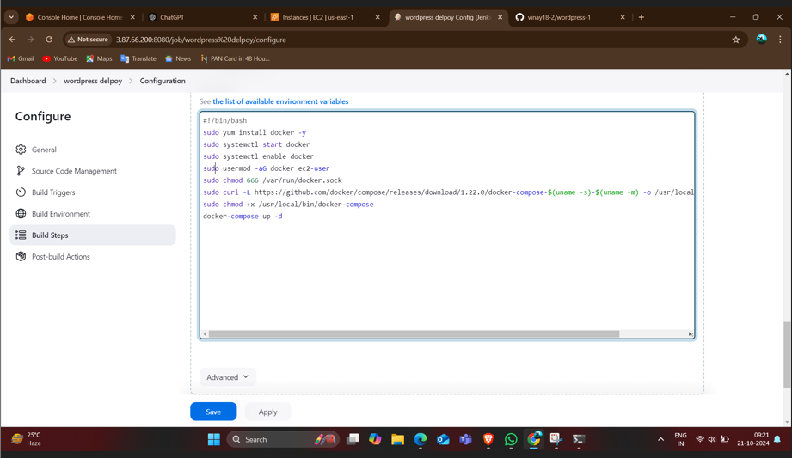


Slide 8
Deploying WordPress with EC2 User Data
Steps for EC2 User Data deployment:
- Create EC2 instance with t3.micro
- Configure security groups for HTTP, HTTPS, SSH
- Use bash script in User Data to install WordPress

Slide 9
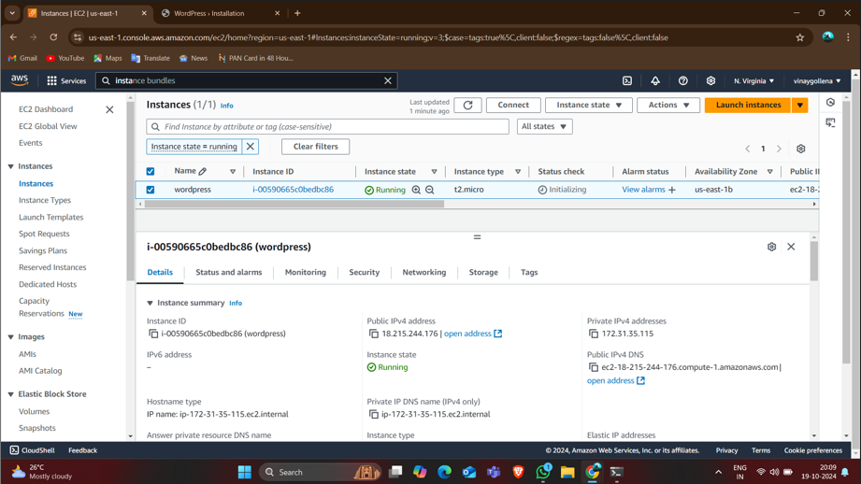
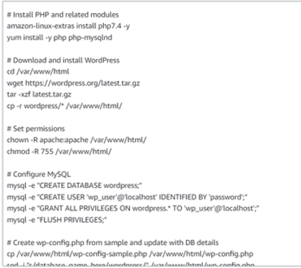
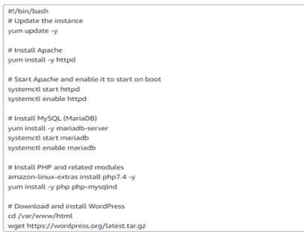
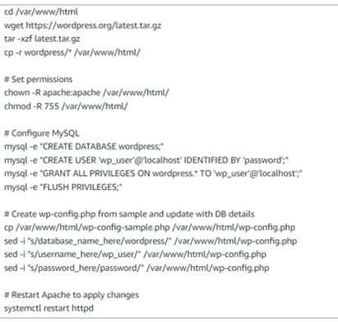
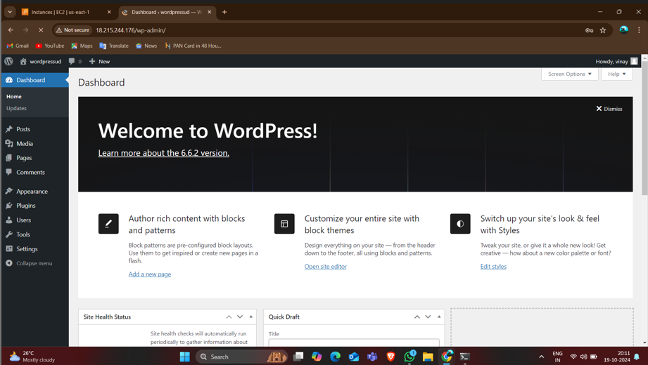

Slide 10
Deployment with jenkins pipeline add build periodically and poll scm
Steps to deploy WordPress with Jenkins:
Create EC2 instance and install Jenkins
Clone WordPress repository using Git
Configure clone job and build job to deploy WordPress
Write the bash script in execute shell in build job.
Install build pipeline plugin and build new view.
Put initial job as clone job and postbuild action as build job and set the schedule for build periodically build that and observe than set the schedule for poll scm before that changes in the script and run observe the output of poll scm.

Slide 11
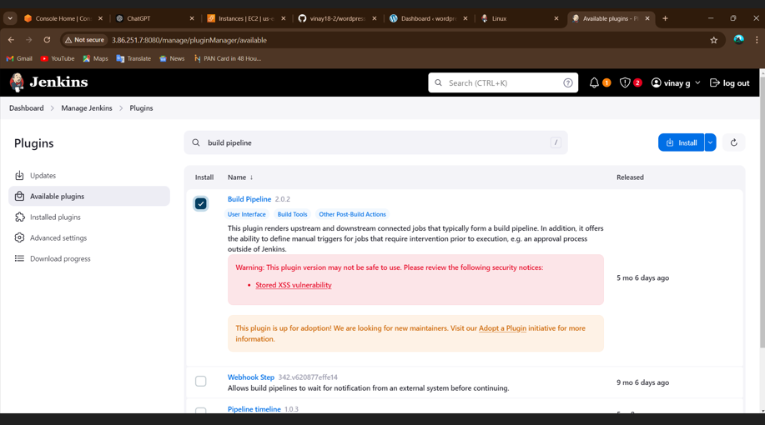
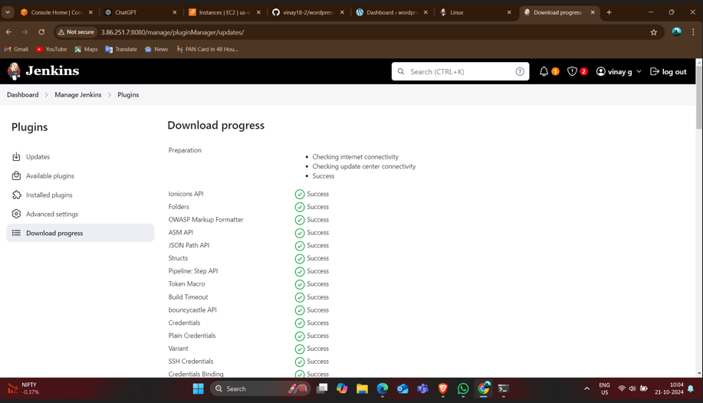
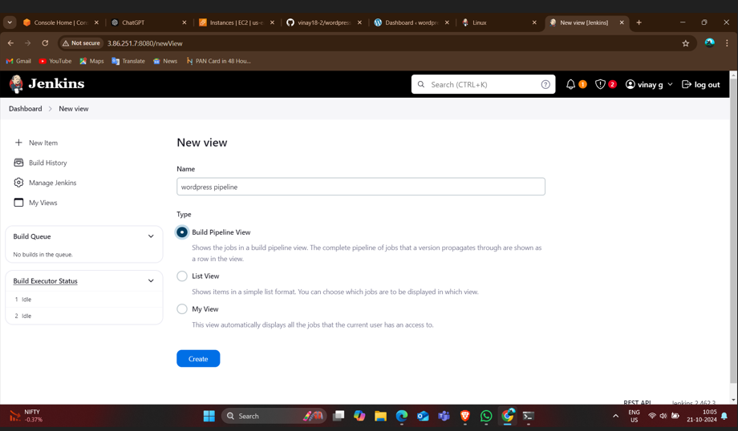
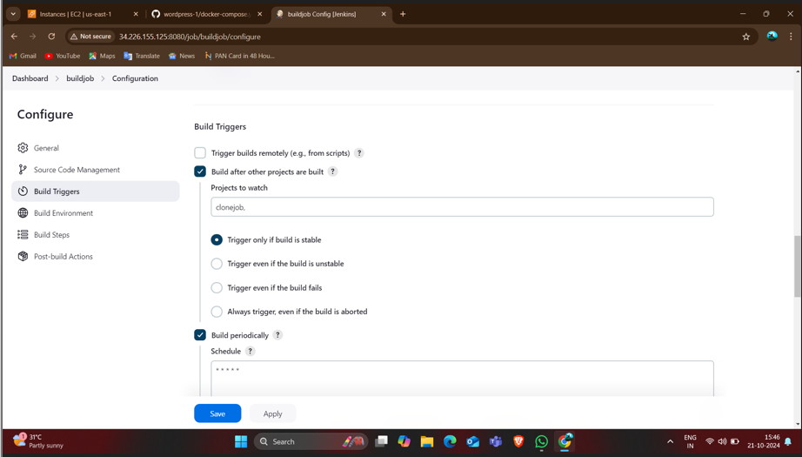
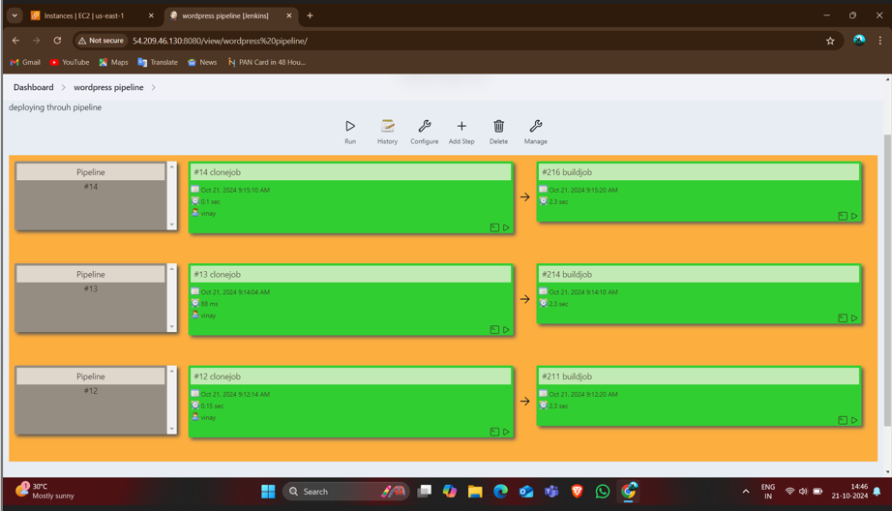
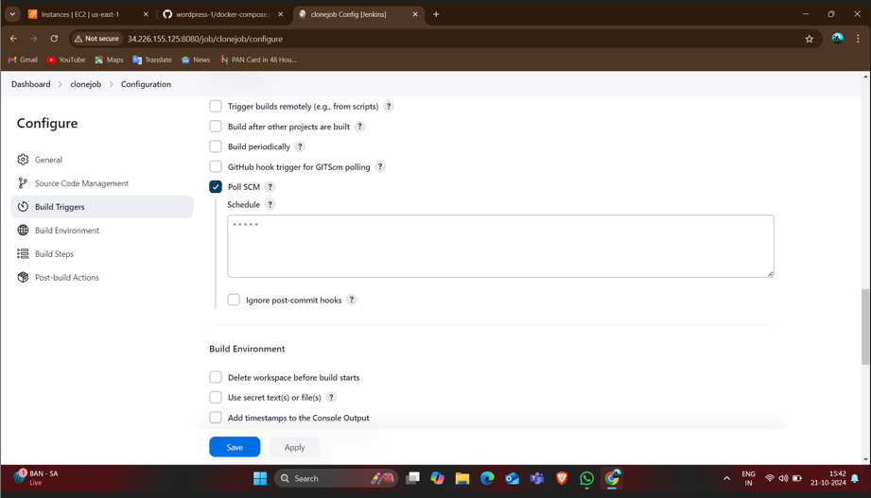
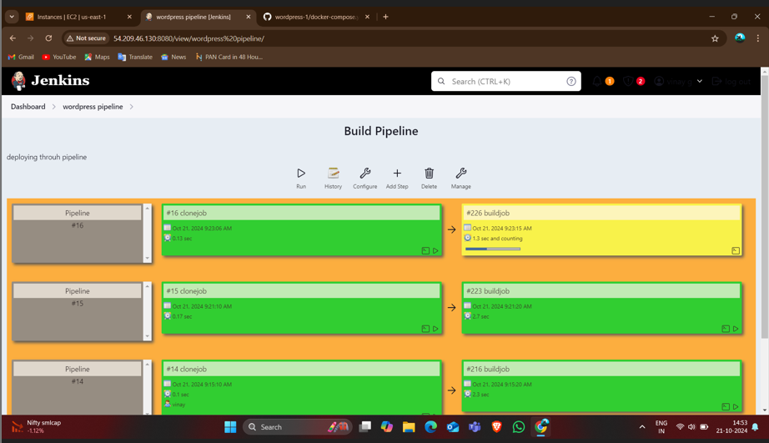

Slide 12
Using Terraform for WordPress Deployment and also with execute shell
Steps to deploy WordPress using Terraform:
Create Terraform scripts to define EC2, VPC, Security Groups
Run Terraform commands: init, validate, plan, apply
Automate infrastructure provisioning

Slide 13
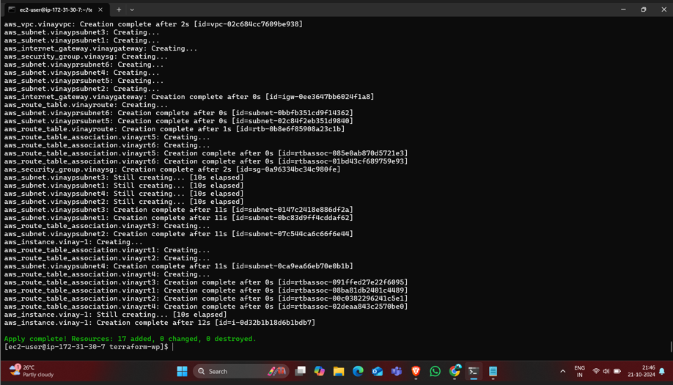
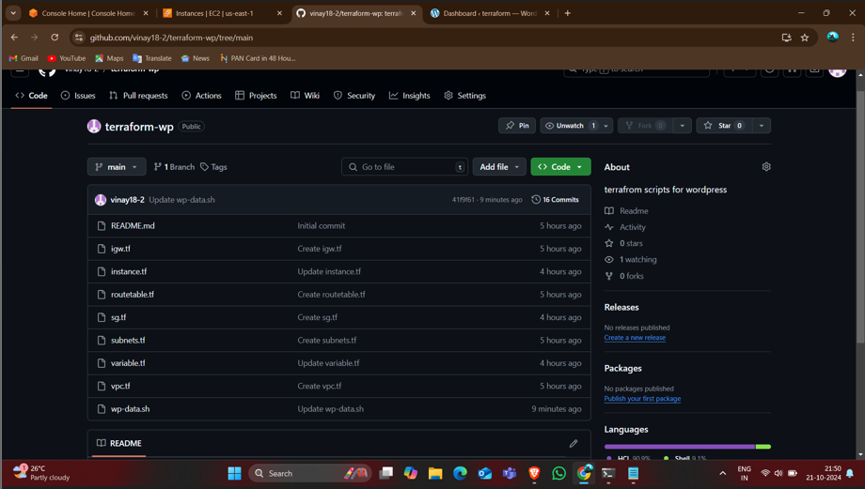
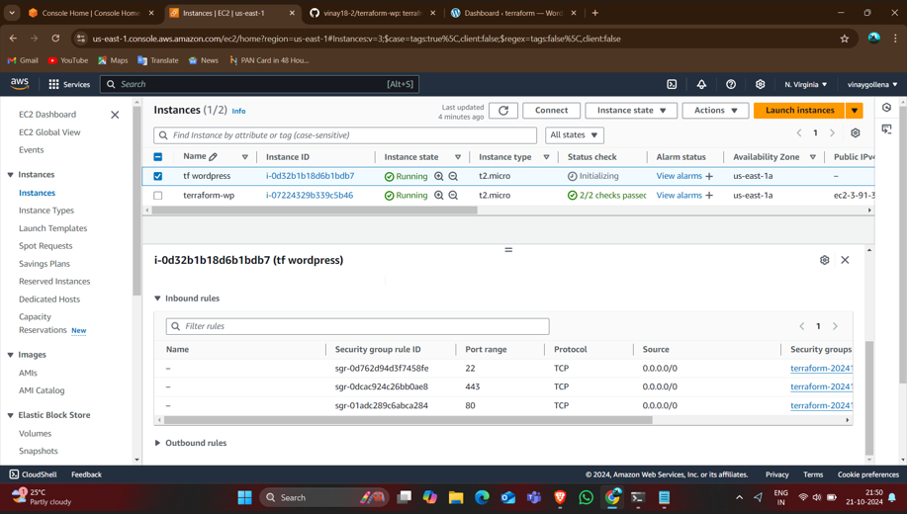
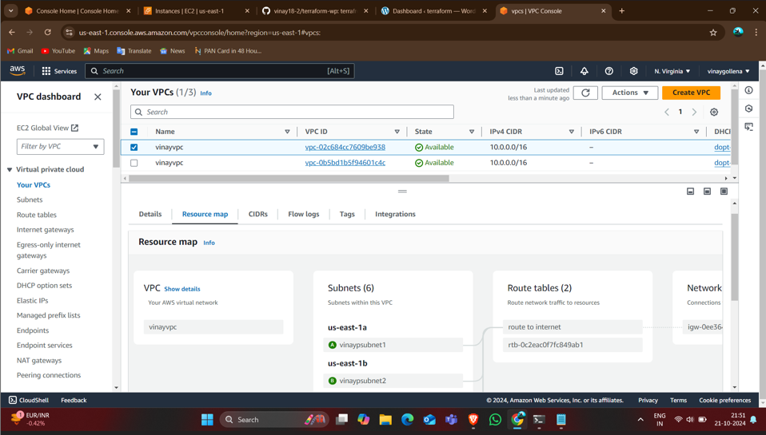
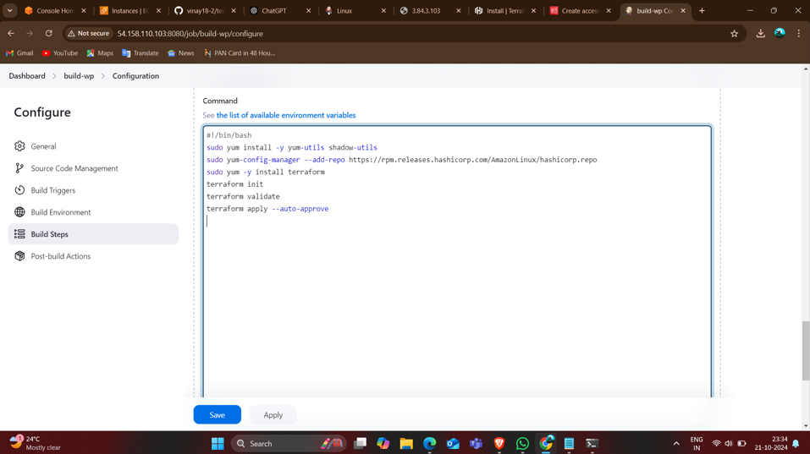
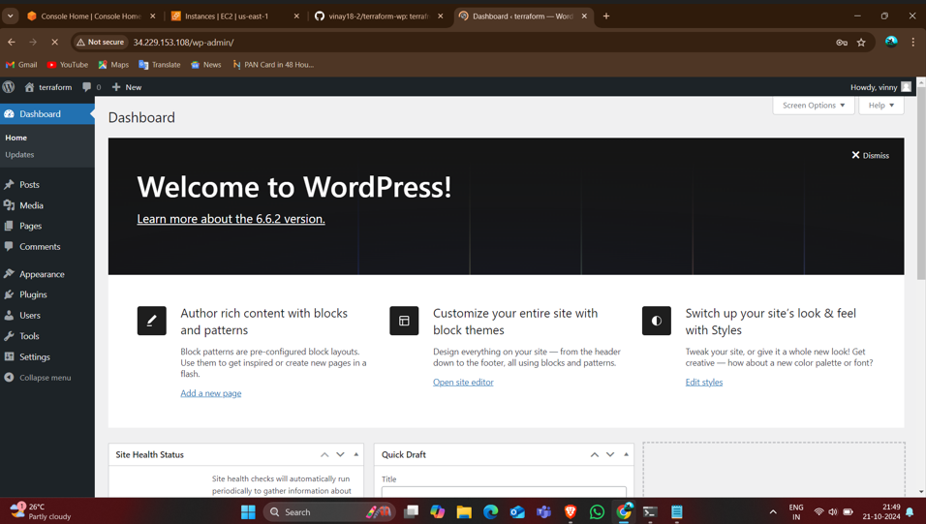

Slide 14
Jenkins Pipeline for WordPress Deployment,buildperiodically and poll scm with Git and with terraform.
Jenkins Pipeline setup:
Set up Jenkins Pipeline with Git
Use build periodically and poll SCM for automation
Deploy WordPress using Jenkins Pipeline

Slide 15
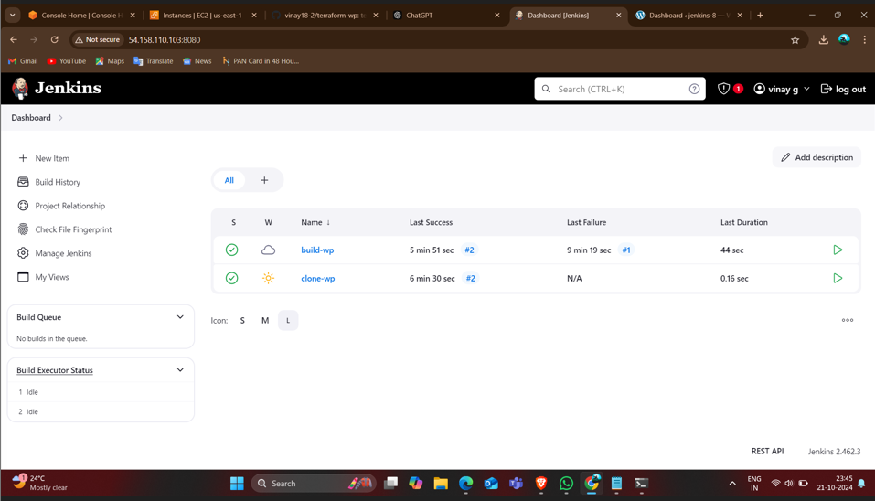
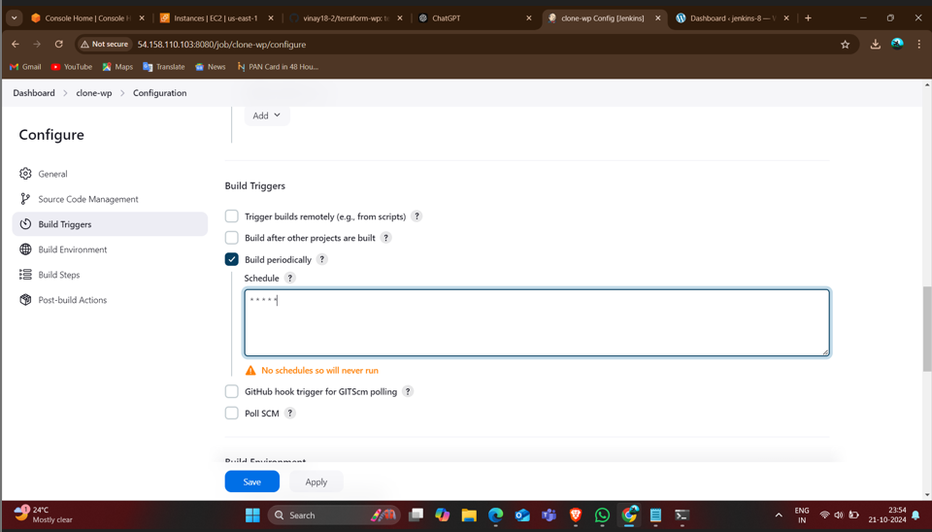
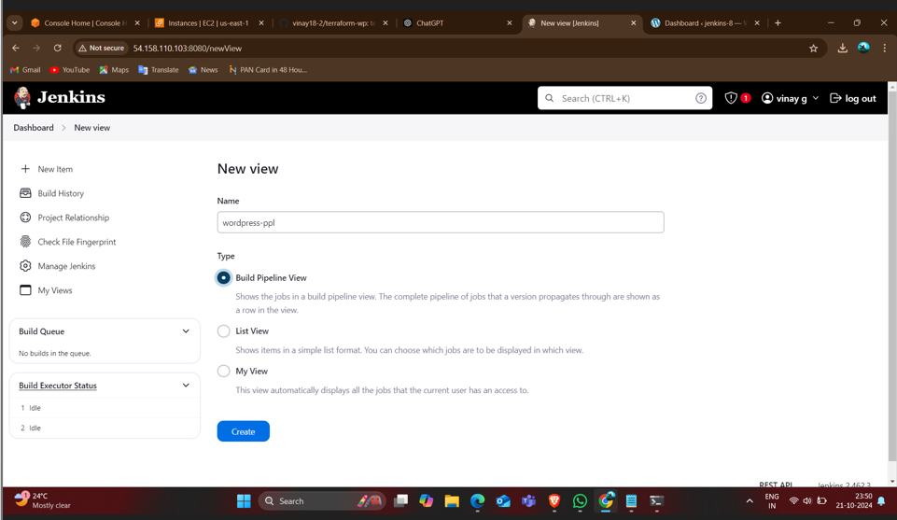
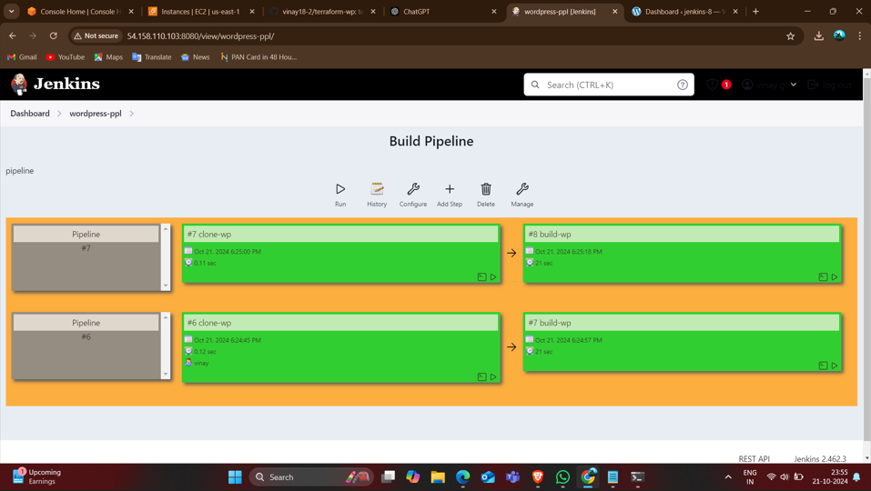
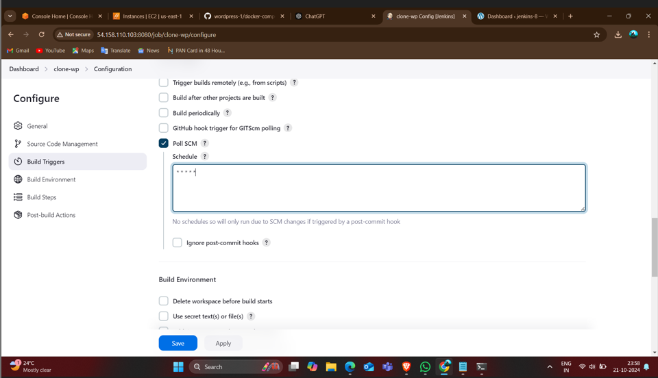
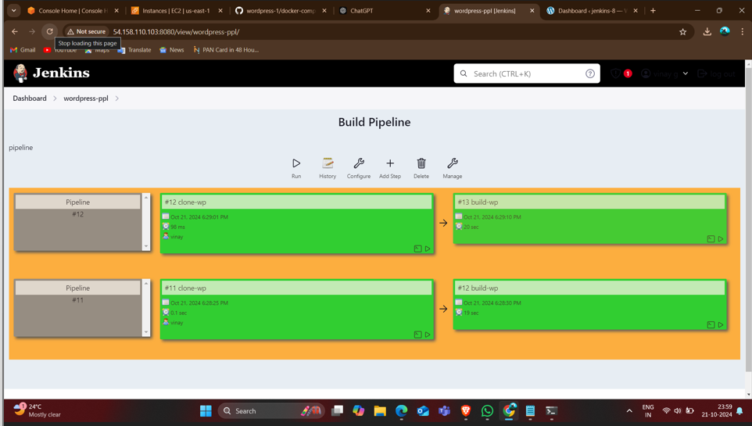

Slide 16
Deploying WordPress on Kubernetes
Kubernetes-based WordPress Deployment:
Create EC2 instances for Docker and Kubernetes
Install Kubernetes (kubectl) and Kops
Create YAML files for deployment and services

Slide 17
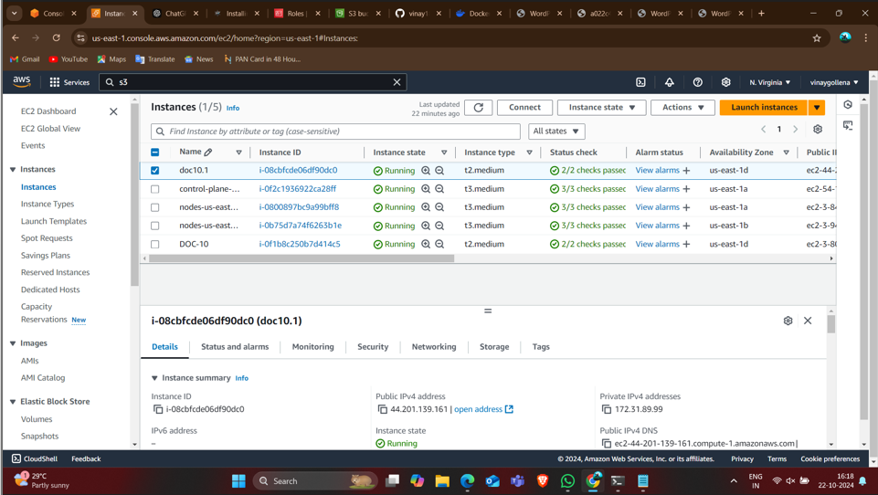
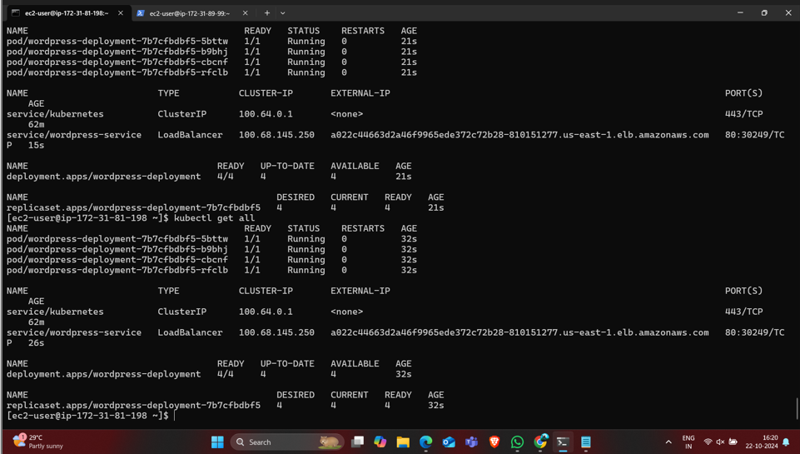
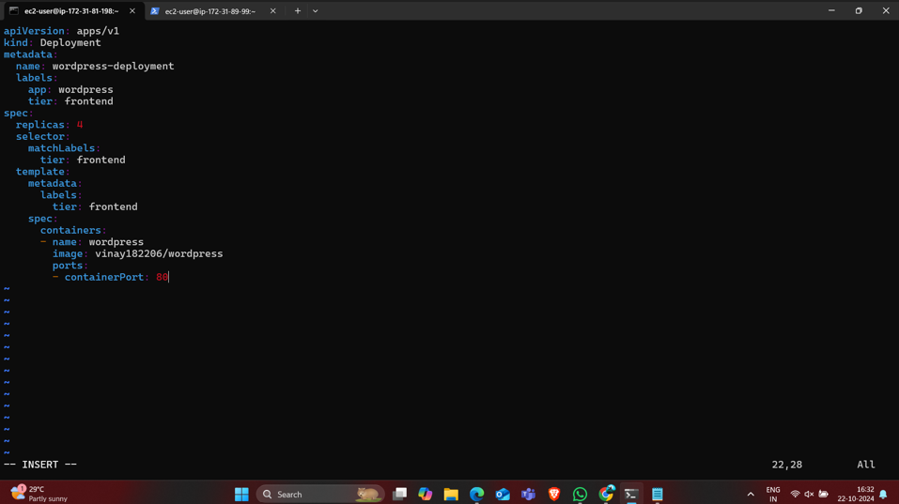
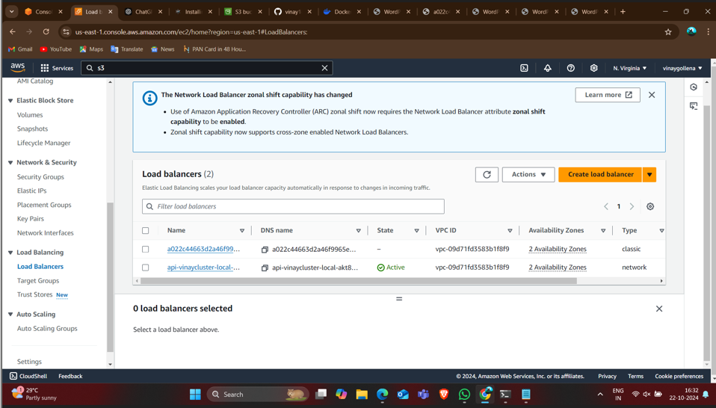
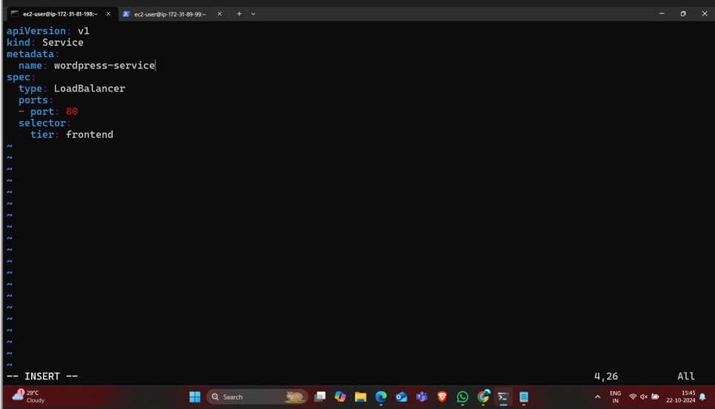
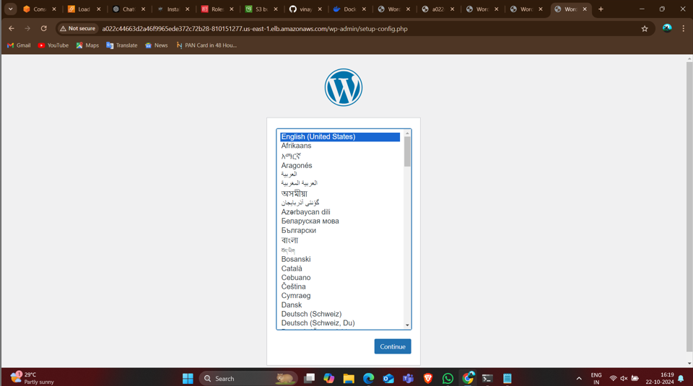

Slide 18
Conclusion
Summary of deployment methods:
AWS RDS and EC2 for manual setup
Docker for containerized deployment
Jenkins and Git for automated deployment
Terraform for infrastructure automation
Kubernetes for scalable deployment

Slide 19


